Slide 1
Lab 06: Sinh viên cài đặt chạy demo các plugins được giới thiệu trong Slides. Notes: 1. Click vào title của từng plugins để vào trang mô tả. 2. Có thể SV cần sử dụng thêm 02 thư viện sau trong các demo: <link rel="stylesheet" href="https://maxcdn.bootstrapcdn.com/bootstrap/3.4.0/css/bootstrap.min.css"> <script src="https://ajax.googleapis.com/ajax/libs/jquery/3.3.1/jquery.min.js"></script>

Slide 2
JQUERY PLUGINS
Thien Khai Tran

Slide 3
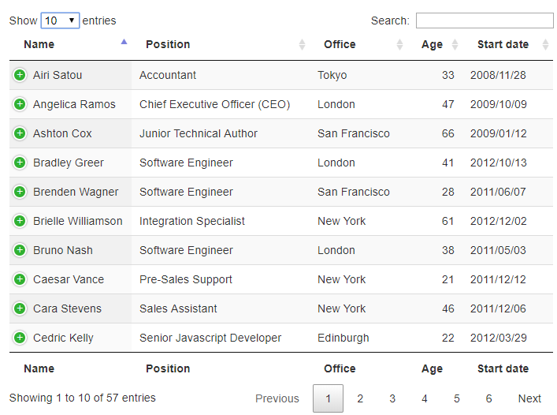
Datatables
DataTables is a plug-in for the jQuery Javascript library. It is a highly flexible tool, build upon the foundations of progressive enhancement, that adds all of these advanced features to any HTML table.

Slide 4

jInvertScroll
This plugin makes it easy to implement horizontal scrolling with a parallax effect. It is a lightweight jQuery plugin that is very easy to set up and requires no configuration.
Being lightweight, it allows you to move in horizontal with a parallax effect.
Notes:
Sd cho ứng dụng gì?
Đọc truyện

Slide 5

Tabslet
Tabslet is a great option for making tabs. The plugin supports custom events, rotation, deep linking, and more. It is easy-to-use and supports browsers like IE7+, Chrome, Firefox, Safari, and so on.
When it comes to compatibility, the plugin supports almost all the latest versions.

Slide 6
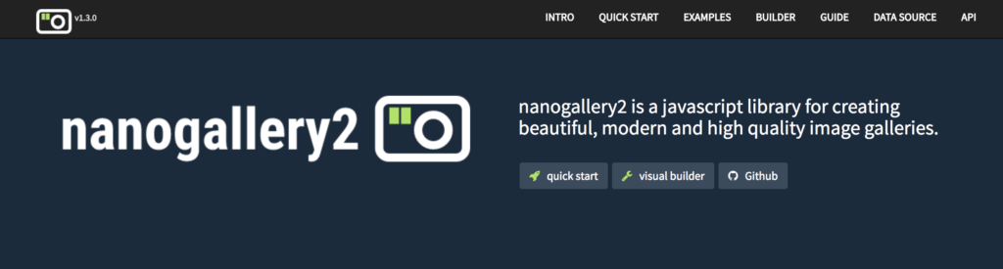
Nanogallery2
This plugin supports the creation of advanced and quality-rich image galleries. Aimed at providing the best user experience, this plugin is high on performance with an enticing image display and an easy builder. Made for both developers and designers, the tool features one of the easiest ways to create image galleries.

Slide 7

Magnific Popup
This is another lightweight jQuery plugin that emphasizes compatibility as well as performance. It is super-fast and works on multiple devices including high-DPI (Retina) devices such as MacBook Pro.
It is a responsive dialog script with focus on performance and providing the best experience for users with any device.

Slide 8

FitText
This jQuery plugin allows you to make font sizes flexible by automatically scaling it up and down. The plugin works perfectly to create scalable headlines by making font-sizes flexible.

Slide 9
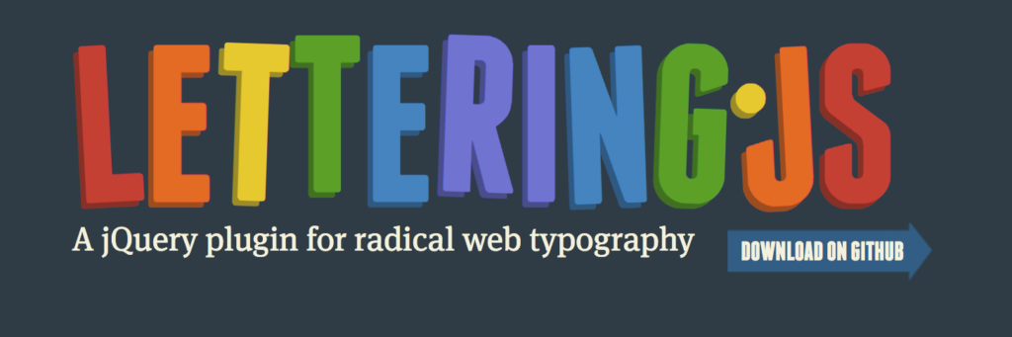
Lettering.js
This plugin provides granular control over individual characters, thereby allowing you to color individual letters, apply event listeners, apply kerning, and more.
It also allows you to play nicely with FitText, thereby giving you desktop style control over typography while remaining responsive at the same time.

Slide 10
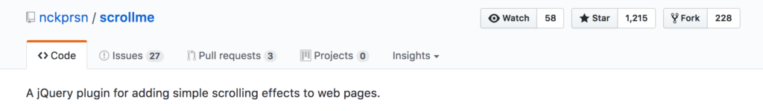
ScrollMe
If you want to add simple scrolling effects to the web page, then ScrollMe jQuery plugin is a viable choice for you. After implementing the plugin on your website, you will be able to rotate, scroll, and translate the density of different elements on the web page. Easy to get started, the plugin does not require knowing a single line of coding.

Slide 11
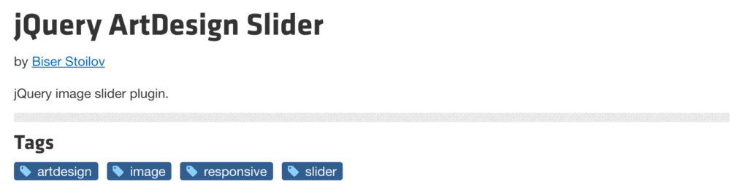
ArtDesign Slider
The tool is an image slider that resizes images with varied dimensions. It supports full height and width with navigation control. It is featured with 24 transition effects, which, in turn, makes it easy to readjust images accordingly.

